Slide 1
Graphs- DFS & BFS codes
3rd Grade
College of Computer Science and Information Technology
Department of Computer Science
Data Structures
Lecture 7 lab
Instructor: Ghazwan Abdulnabi Al-Ali
University of Basrah, Iraq

Slide 2
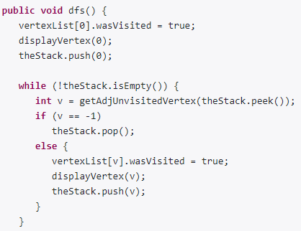
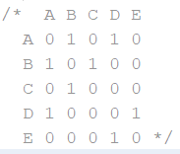
DFS Code
G₁
A
0 | A | T
1 | B | F
2 | C | F
3 | D | F
4 | E | F
B
D
C
E
stack
A

Slide 3
DFS Code
G₁
A
0 | A | T
1 | B | F
2 | C | F
3 | D | F
4 | E | F
B
D
C
E
stack
A

Slide 4
DFS Code
G₁
A
0 | A | T
1 | B | T
2 | C | F
3 | D | F
4 | E | F
B
D
C
E
stack
A | B

Slide 5
DFS Code
G₁
A
0 | A | T
1 | B | T
2 | C | F
3 | D | F
4 | E | F
B
D
C
E
stack
A | B

Slide 6
DFS Code
G₁
A
0 | A | T
1 | B | T
2 | C | T
3 | D | F
4 | E | F
B
D
C
E
stack
A | B | C

Slide 7
DFS Code
G₁
A
0 | A | T
1 | B | T
2 | C | T
3 | D | F
4 | E | F
B
D
C
E
stack
A | B | C

Slide 8
DFS Code
G₁
A
0 | A | T
1 | B | T
2 | C | T
3 | D | F
4 | E | F
B
D
C
E
stack
A | B | C

Slide 9
DFS Code
G₁
A
0 | A | T
1 | B | T
2 | C | T
3 | D | F
4 | E | F
B
D
C
E
stack
A | B | C

Slide 10
DFS Code
0 | A | T
1 | B | T
2 | C | T
3 | D | F
4 | E | F
G₁
A
B
D
C
E
stack
A | B

Slide 11
DFS Code
0 | A | T
1 | B | T
2 | C | T
3 | D | F
4 | E | F
G₁
A
B
D
C
E
stack
A | B

Slide 12
DFS Code
0 | A | T
1 | B | T
2 | C | T
3 | D | F
4 | E | F
G₁
A
B
D
C
E
stack
A

Slide 13
DFS Code
0 | A | T
1 | B | T
2 | C | T
3 | D | F
4 | E | F
G₁
A
B
D
C
E
stack
A

Slide 14
DFS Code
0 | A | T
1 | B | T
2 | C | T
3 | D | T
4 | E | F
G₁
A
B
D
C
E
stack
A | D

Slide 15
DFS Code
0 | A | T
1 | B | T
2 | C | T
3 | D | T
4 | E | F
G₁
A
B
D
C
E
stack
A | D

Slide 16
DFS Code
0 | A | T
1 | B | T
2 | C | T
3 | D | T
4 | E | T
G₁
A
B
D
C
E
stack
A | D | E

Slide 17
DFS Code
0 | A | T
1 | B | T
2 | C | T
3 | D | T
4 | E | T
G₁
A
B
D
C
E
stack

Slide 18
BFS Code

Slide 19
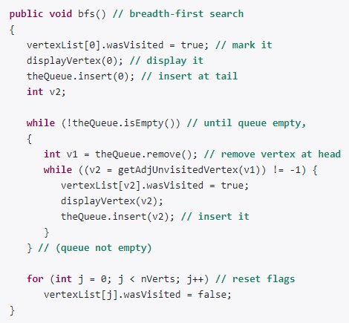
BFS Code
G₁
A
0 | A | F
1 | B | F
2 | C | F
3 | D | F
4 | E | F
B
D
C
E
queue

Slide 20
BFS Code
G₁
A
0 | A | T
1 | B | F
2 | C | F
3 | D | F
4 | E | F
B
D
C
E
queue
A

Slide 21
BFS Code
G₁
A
0 | A | T
1 | B | F
2 | C | F
3 | D | F
4 | E | F
B
D
C
E
queue
A

Slide 22
BFS Code
G₁
A
0 | A | T
1 | B | F
2 | C | F
3 | D | F
4 | E | F
B
D
C
E
queue

Slide 23
BFS Code
G₁
A
0 | A | T
1 | B | F
2 | C | F
3 | D | F
4 | E | F
B
D
C
E
queue

Slide 24
BFS Code
G₁
A
0 | A | T
1 | B | T
2 | C | F
3 | D | F
4 | E | F
B
D
C
E
queue
B

Slide 25
BFS Code
G₁
A
0 | A | T
1 | B | T
2 | C | F
3 | D | F
4 | E | F
B
D
C
E
queue
B

Slide 26
BFS Code
G₁
A
0 | A | T
1 | B | T
2 | C | F
3 | D | T
4 | E | F
B
D
C
E
queue
B | D

Slide 27
BFS Code
G₁
A
0 | A | T
1 | B | T
2 | C | F
3 | D | T
4 | E | F
B
D
C
E
queue
D

Slide 28
BFS Code
G₁
A
0 | A | T
1 | B | T
2 | C | F
3 | D | T
4 | E | F
B
D
C
E
queue
D

Slide 29
BFS Code
G₁
A
0 | A | T
1 | B | T
2 | C | F
3 | D | T
4 | E | F
B
D
C
E
queue
D

Slide 30
BFS Code
G₁
A
0 | A | T
1 | B | T
2 | C | T
3 | D | T
4 | E | F
B
D
C
E
queue
D | C

Slide 31
BFS Code
G₁
A
0 | A | T
1 | B | T
2 | C | T
3 | D | T
4 | E | F
B
D
C
E
queue
C

Slide 32
BFS Code
G₁
A
0 | A | T
1 | B | T
2 | C | T
3 | D | T
4 | E | F
B
D
C
E
queue
C

Slide 33
BFS Code
G₁
A
0 | A | T
1 | B | T
2 | C | T
3 | D | T
4 | E | F
B
D
C
E
queue
C

Slide 34
BFS Code
G₁
A
0 | A | T
1 | B | T
2 | C | T
3 | D | T
4 | E | T
B
D
C
E
queue
C | E

Slide 35
Thank You

